Slide 1

Cs 429:DATA MINING Lecture 11
Instructor:
Osama Ahmed Khan
osamaahmedkhan
Jul 10th, 2017

Slide 2
Divide-and-Conquer: Constructing Decision Trees
Issues:
Termination only when all leaf nodes are pure (i.e. all have same classification)
Biased towards attributes having large number of values
Solutions:
Termination when data can not be split any further
Gain Ratio

Slide 3
Divide-and-Conquer: Constructing Decision Trees
Highly Branching Attributes
ID code
Outlook
Temperature
Humidity
Windy
Play
a
sunny
hot
high
false
no
b
sunny
hot
high
true
no
c
overcast
hot
high
false
yes
d
rainy
mild
high
false
yes
e
rainy
cool
normal
false
yes
f
rainy
cool
normal
true
no
g
overcast
cool
normal
true
yes
h
sunny
mild
high
false
no
i
sunny
cool
normal
false
yes
j
rainy
mild
normal
false
yes
k
sunny
mild
normal
true
yes
l
overcast
mild
high
true
yes
m
overcast
hot
normal
false
yes
n
rainy
mild
high
true
no

Slide 4
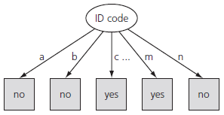
Divide-and-Conquer: Constructing Decision Trees
Highly Branching Attributes
info([0,1]) + info([0,1]) + info([1,0]) + … + info([0,1]) = 0
Errorless Classification
gain(id code) = info([9,5]) – 0
= info([9,5]) = 0.940 bits

Slide 5
Divide-and-Conquer: Constructing Decision Trees
Highly Branching Attributes
Biased attribute selection
Gain Ratio
Considers Number of Leaf Nodes
Considers Size of Leaf Nodes
Disregards Class information
split info([1,1,…,1]) = {-1/14 x log(1/14)} x 14
= log 14
= 3.807 bits

Slide 6

Divide-and-Conquer: Constructing Decision Trees
Gain Ratio = $\frac{\text{Information} \text{Gain}}{\text{Split} \text{Information}}$
= $\frac{\text{gain}\text{(}\text{id} \text{code}\text{)}}{\text{split} \text{info}\text{(}\text{[1,1,…,1])}}$
= $\frac{\text{0.940}}{\text{3}\text{.}\text{807}}$
= 0.247

Slide 7
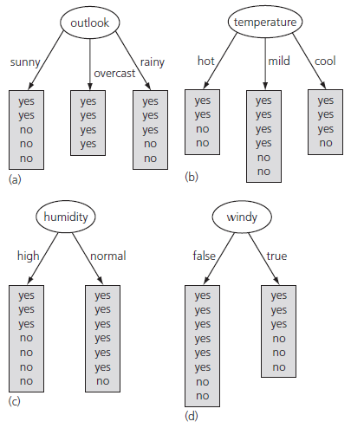
Divide-and-Conquer: Constructing Decision Trees

Slide 8
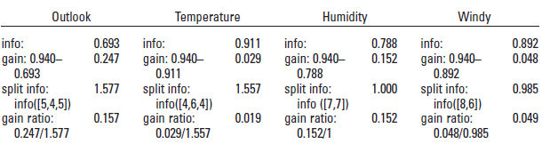
Divide-and-Conquer: Constructing Decision Trees
Humidity closer to Outlook
ID code still best?
Ad hoc Test

Slide 9
Divide-and-Conquer: Constructing Decision Trees
ID3: Iterative Dichotomiser 3
C4.5: Classifier 4.5

Slide 10
Algorithms
Inferring Rudimentary Rules
Statistical Modeling
Divide-and-Conquer: Constructing Decision Trees
Covering Algorithms: Constructing Rules
Mining Association Rules
Linear Models
Instance-Based Learning
Clustering

Slide 11
Covering Algorithms: Constructing Rules
Covering Algorithm:
Covers all instances of a single class
Rule Set vs. Decision Tree
 | Divide-and-Conquer | Cover
Approach | Top-down | Bottom-up
Classes | All | Single
Splitting | Attribute | Class

Slide 12
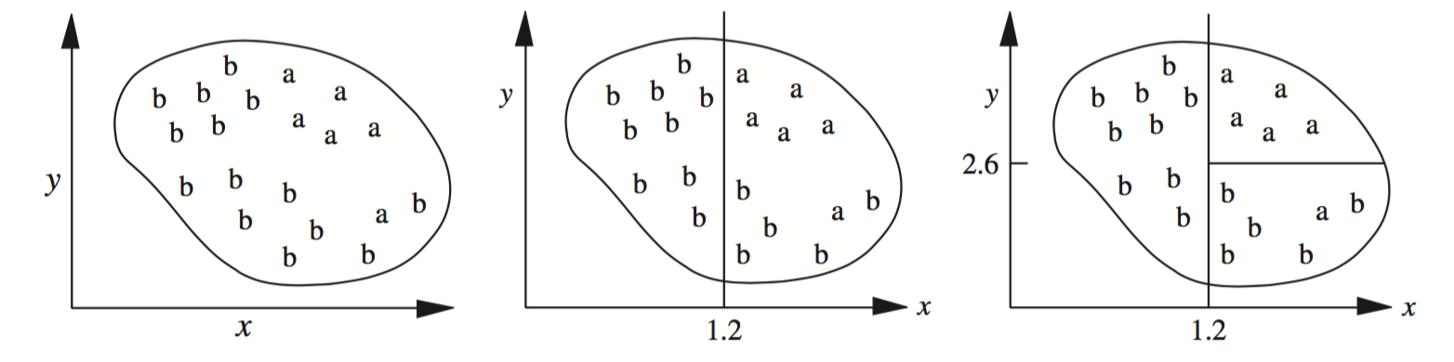
Covering Algorithms: Constructing Rules
Rule Set 1
1.
2.
3.
If x > 1.2 then class = a
If x > 1.2 then class = a
If x > 1.2 and y > 2.6 then class = a
If x > 1.2 then class = a
If x > 1.2 and y > 2.6 then class = a
If x > 1.4 and y < 2.4 then class = a

Slide 13
Covering Algorithms: Constructing Rules
Rule Set 2
1.
2.
If x <= 1.2 then class = b
If x <= 1.2 then class = b
If x <= 1.2 and y <= 2.6 then class = b

Slide 14
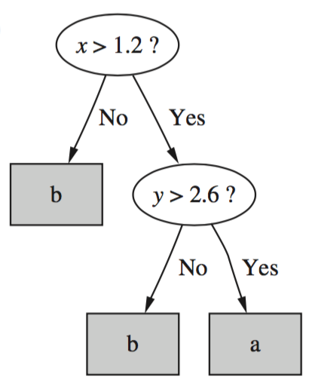
Covering Algorithms: Constructing Rules
Decision Tree

